Slide 1
Intro to React

Slide 2
Everyone interact with a website or apps almost on daily bases.
E.g. facebook, X (formarly know as twitter), intagram
Websites has two parts
Front end or client side
Which user can see and interact with
E.g. facebook like button, signIn or signup forms
Back end or server side
Which is handling business logics and storing data
E.g. saving posts, saving user information, authentication logic of users and more
We are going to talk about fornt end or client side
Lets get started

Slide 3
What is react?
React, sometimes referred to as a frontend JavaScript framework, is a JavaScript library created by Facebook.
React is a tool for building User interface components.
What is a component?
What is a house made of?
Bricks, doors, cement , electric wiring.
We place all these things in a certain order to make a desired house
So you can say that bricks doors and cements electrical wiring all are the components of a house. When they placed in certain order they make a house.
Like wise to make a website, we first make its components and then place it in a certain order to make our desired website.

Slide 4
Core concepts
Re-usability
Uni directional data flow parent to child only
Virtual dom or shadow dom

Slide 5
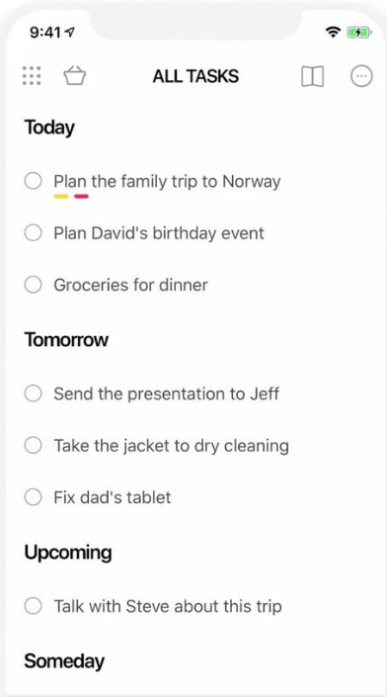
How does React Work?
React only changes what needs to be changed!
React finds out what changes have been made, and changes only what needs to be changed.
It saves recourses and increase efficiency
In this todo app. Suppose if user mistakenly entered wrong country name in first Todo. When he will edit it to correct country name e.g. Sweden. The react will detect where change is intended. Then rather refreshing all the page and reloading all the things again. React just change first todo when actually change is intended. It saves resources and it is efficient and fast.

Slide 6
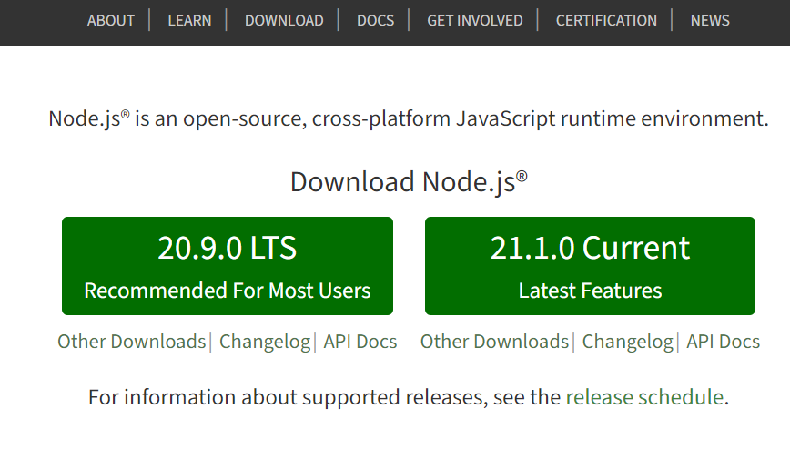
Installation
You can skip installation if you already have it on your system
To use React, you need npm which is included with Node.js.
Npm ➔ node package manager
Package is a peace of code which can offer certain functionality. Node package manager manages a lot of packages developed by people all over the world. They are free to use and you can use any package functionality that you want to implement in your project.
Go to https://nodejs.org/en
download and install LTS (Long term support) version

Slide 7
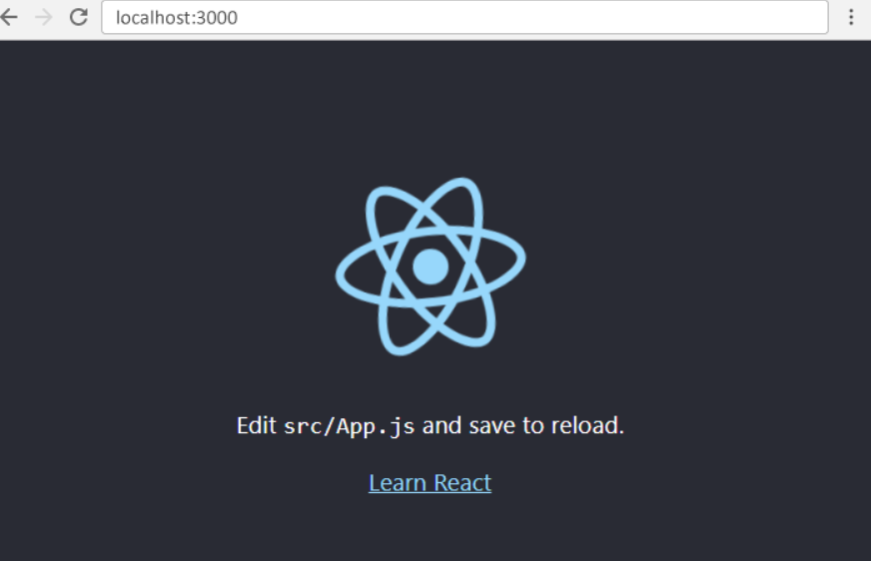
Setting a react project
Go to where you want to create your project.
Open Command prompt in this directory
Write following command
Npx create-react-app <your-project-name>
This command will create a react project.
It will take some time depends upon internet speed. So sit tight
When finished go to your project directory by
Cd < your-project-name>
Npm start ➔ this will run the react app in your browser

Slide 8
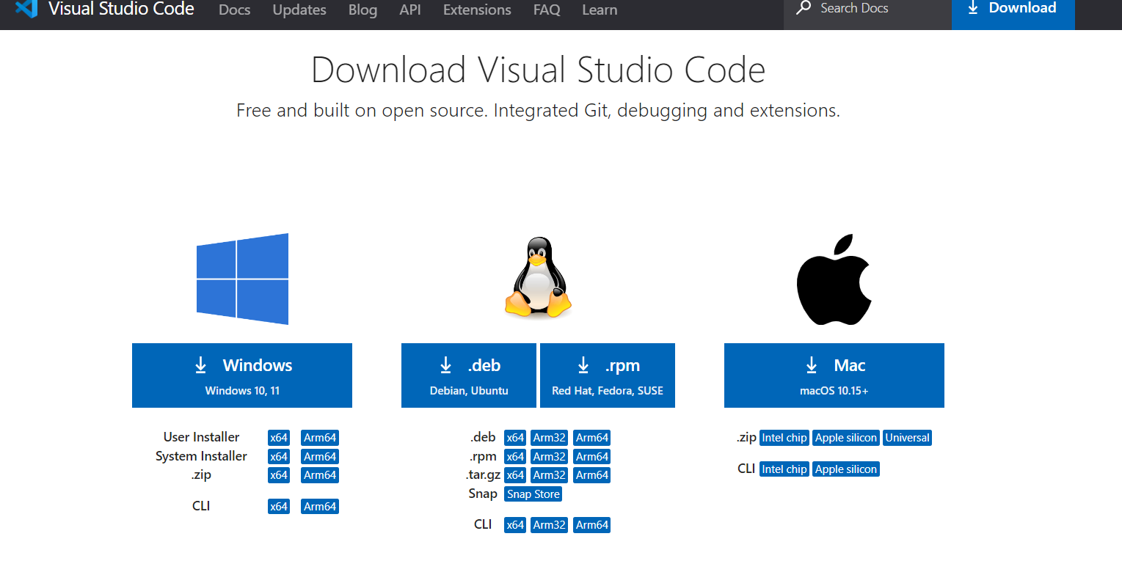
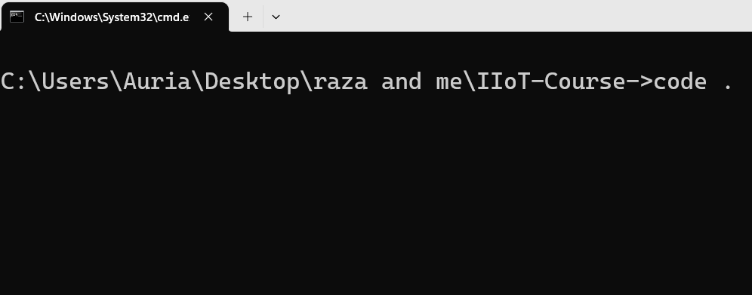
Code Editior
We’ll use visual studio code as a code editior.
https://code.visualstudio.com/download
Install it accourding to your system.
Once installed
Open project in vs code
Go to project directory in cmd
And hit following command
Code .
It will open vs code with your project file

Slide 9
UI of Project
Lets see UI of project first before jump into coding
Figma desing display and explain a little signIn and signup pages

Slide 10
First component
How to think of components?
Think of it as a building block or something same that will use on various places. E.g. analogy. There are serveral doors in a house. Same door design will use in many places. Same kinds of bricks will use in walls. But there is only one main gate.
Like wise. There will be serveral buttons that will be same in a website. Serveral intput feels that will be same. We need to design them once and reuse that design again and again. May be a component will use only once like main gait of house and will never be used again. So this is also a building block
Lets get to coding and make our first building block
Lets desing Our first component ➔ button

